Slide 1
Jeopardy Instructions
Four groups of 5 people each.
One person from your group chooses a colour and then a number eg. Blue 2. Each number represents the points you will get for answering the questions correctly. You have 15 seconds to discuss your answer and then you must state it aloud.
You must begin your answer with ‘What is’. For example – If the question was ‘What time does school finish?’ you would answer with ‘What is 3.15pm’. If you don’t answer correctly, you do not get the points.
If a team cannot answer their question or they get it wrong, other teams can ‘buzz in’ to answer it. If another team answers the question correctly, they get double points.
We will determine which group will start first. Then we move around the room in a clockwise direction.
Team with the most points wins!!! I have some prizes.

Slide 2
Economics - Jeopardy
Blue
Green
Brown
Purple
Red
1
1
1
1
1
2
2
2
2
2
3
3
3
3
3
4
4
4
4
4
5
5
5
5
5

Slide 3
Blue - 1
What is a system of exchange whereby one person trades their good or service for another person’s good or service.
What is “barter”.

Slide 4
Blue - 2
The needs and wants of people are unlimited but the resources available to satisfy them are limited. This is known as…….
What is “the economic problem”.

Slide 5
Blue - 3
Name the four types of economic resources
What is “land, labour, capital and enterprise”.

Slide 6
Blue - 4
Good decision making skills and a willingness to take risks would be an example of this type of resource
What is “enterprise”.

Slide 7
Blue - 5
A ………………. is any system that allows buyers and sellers to interact to trade goods and services.
What is “market”.

Slide 8
Green - 1
What is the total of all activities undertaken for the purpose of producing, distributing and consuming the goods and services we require to satisfy our needs and wants?
What is “the economy”.

Slide 9
Green - 2
Who are the four participants in the economy?
What is “businesses/producers, consumers/households, financial and government sectors”.

Slide 10
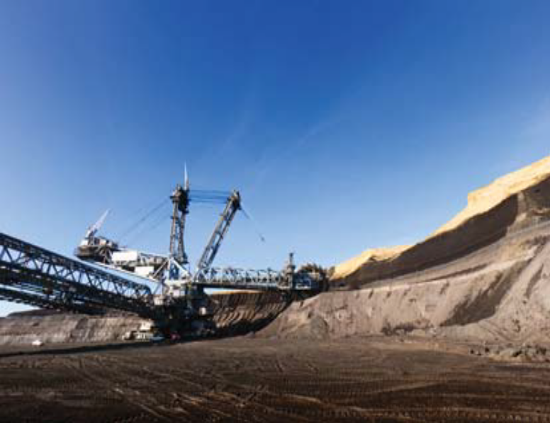
Green - 3
Resources of the business sector fit into four categories. The picture is showing which type of resource?
What is “land”.

Slide 11
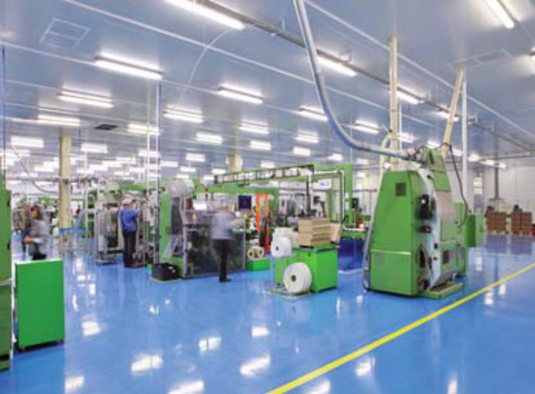
Green - 4
Resources of the business sector fit into four categories. The picture is showing which type of resource?
What is “capital”.

Slide 12
Green - 5
Money performs the following four very important functions in our economic system. Name one.
What is
  “Medium of exchange”
  “Measure of value”
  “Store of value”
  “Standard of deferred payment”

Slide 13
Brown - 1
When people focus on producing just one good or service, this is know as?
What is “specialisation”.

Slide 14
Brown - 2
What is the word for having exclusive possession or control of the supply or trade in a commodity or service?
What is “monopoly”.

Slide 15
Brown - 3
Goods sent overseas from Australia are called
What is “exports”.

Slide 16
Brown - 4
In which type of economy does the government take ownership of all means of production?
What is “communist”.

Slide 17
Brown - 5
Name one thing that causes inflation
What is “money supply goes up”
What is “supply of goods goes down”
What is “demand for money goes down”
What is “demand for goods goes up”

Slide 18
Purple - 1
If the government wanted people to spend more, it would …………….. taxes on the people.
What is “decrease”.

Slide 19
Purple - 2
Banks reward savers with what?
What is “interest”.

Slide 20
Purple - 3
If the government wanted people to save more, it would ………….. interest rates.
What is “increase”.

Slide 21
Purple - 4
What is the term used when you use as little natural resources as possible?
What is “conserving or conservation”.

Slide 22
Purple - 5
What is the goal of any business? It is what is left of income after expenses are deducted.
What is “profit”.

Slide 23
Red - 1
How does the government make money?
What are “taxes”.

Slide 24
Red - 2
Name 1 way governments spend money.
What are
  “Welfare payments”
  “Essential services – roads, schools, hospitals, police”

Slide 25
Red - 3
When Australian brings goods into the country, this is an example of?
What is “importing”.

Slide 26
Red - 4
Australia has a close relationship with which global region?
What is “the Asia-Pacific Region”.

Slide 27
Red - 5
Governments use the money they collect to provide community services such as schools, roads, and police and defence forces. When they choose to make an investment in schools instead of defence forces, this is known as?
What is “opportunity cost”.

